Slide 1
Distributed Execution of Spiking Neural Networks
Harsh Singh
M5298103
31/01/2026

Slide 2
Content
Introduction
Motivation
Research Background
Problem Statement
Proposed Method
Research Progress
Plan & Schedule

Slide 3
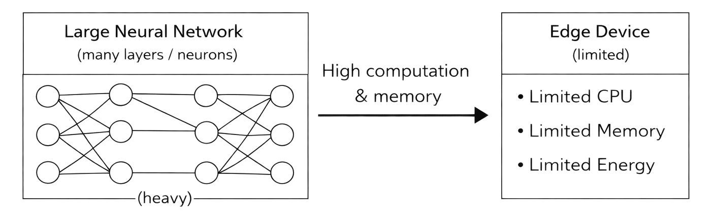
Introduction
Embedded and edge devices have limited computation and memory
Running large neural networks on a single device is difficult
Energy efficiency and scalability are important challenges
This figure shows why large neural networks are difficult to run on resource-limited edge devices.

Slide 4
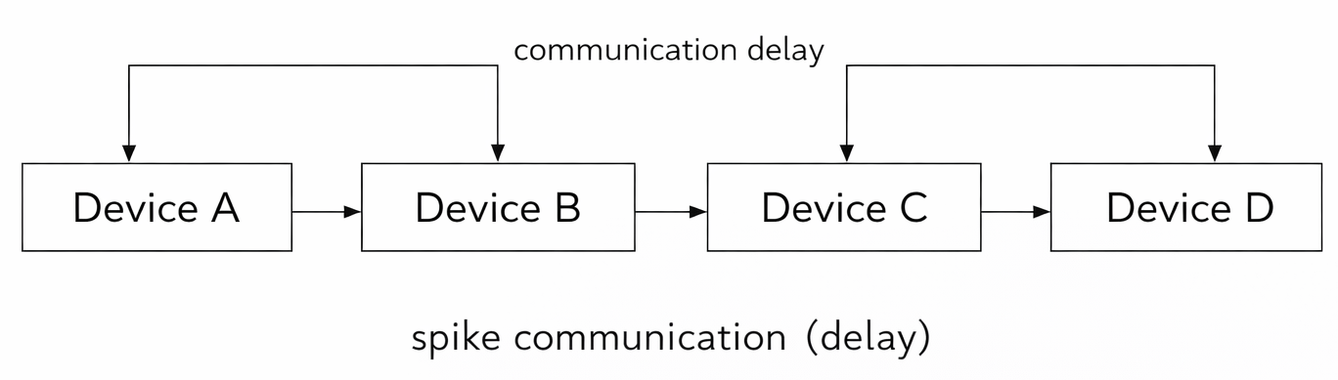
Motivation
Distributed execution can improve performance and scalability
Spiking Neural Networks (SNNs) are energy efficient
However, communication delay affects accuracy and stability
This figure illustrates spike communication between devices and the impact of communication delay in distributed execution

Slide 5
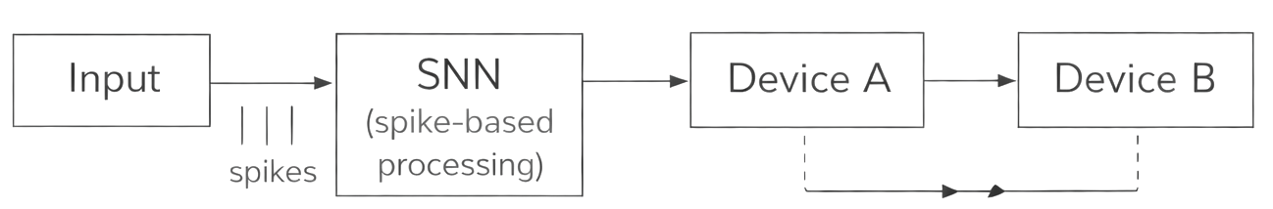
Research Background
SNNs process information using spikes
Suitable for low-power and neuromorphic systems
Distributed SNN execution introduces synchronization issues
synchronization issues
This figure shows how SNNs process information using spikes and how distribution introduces synchronization issues.

Slide 6
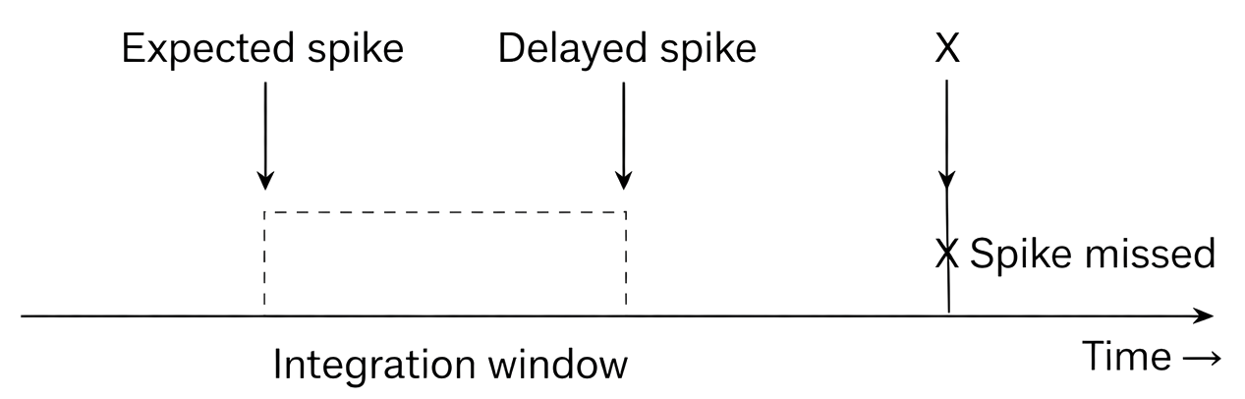
Problem Statement
Distributed execution of SNNs across multiple devices
Communication delay between devices
Delayed or missing spikes
Performance degradation
Expected spike
Delayed spike
Spike missed
Integration Window
Time
This figure demonstrates how communication delay leads to delayed or missing spikes and performance degradation

Slide 7
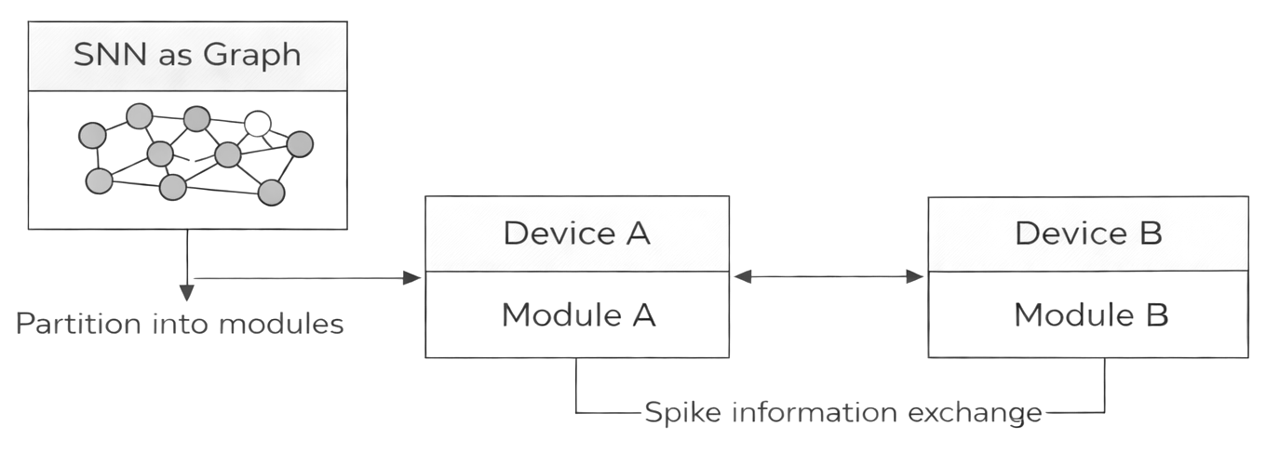
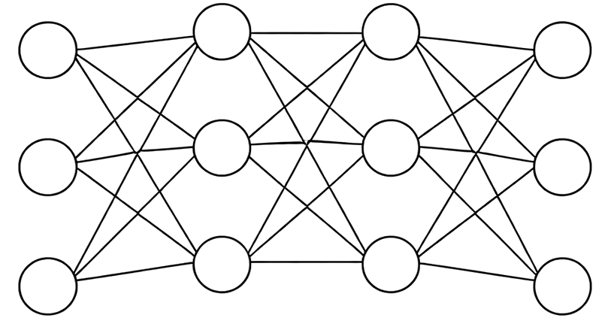
Proposed Method
Represent SNN as a graph
Partition the network into modules
Deploy modules on multiple device
Exchange spike information between devices
This figure shows the proposed approach of representing an SNN as a graph, partitioning it, and deploying modules across devices

Slide 8
Solution Overview
Represent the spiking neural network as a graph
Partition the network into smaller modules
Deploy modules on multiple devices and exchange spike information between them
SNN as Graph
Partition
Module 1
Module 2
Deploy
Device A
Device B
Spike information exchange
This figure summarizes how graph partitioning and controlled spike exchange enable efficient distributed SNN execution.

Slide 9
Research Progress So Far
Studied PyTorch fundamentals, including tensors, computation graphs, and training workflow
Implemented basic neural network training using PyTorch (model, loss, optimizer)
Completed classification experiments on standard datasets
Studied basic computer vision pipelines and data preprocessing
Implemented and analyzed Ensemble-STDP on MNIST
Documented experiments and results in structured research reports
Maintained all progress and reports in a version-controlled GitHub repository

Slide 10
Schedule
Step / Task | AY2026 Q1 | AY2026 Q2 | AY2026 Q3 | AY2026 Q4 | AY2027 Q1 | AY2027 Q2 | AY2027 Q3 | AY2027 Q4
Background & partitioning | → | →
Mapping & baseline |  | → | →
Distributed deployment |  |  | → | → | →
Optimization & delay handling |  |  |  | → | → | →
Final thesis |  |  |  |  |  |  | → | →

Slide 11
References
[1] E. Baccour et al., “Pervasive AI for IoT applications: A survey on resource-efficient distributed artificial intelligence,” IEEE Communications Surveys & Tutorials, vol. 24, no. 4, pp. 2366–2418, 2022.
[2] A. B. Abdallah and K. N. Dang, “Neuromorphic Computing Principles and Organization.”
[3] Y. Hanyu and K. N. Dang, “EnsembleSTDP: Distributed in-situ Spike Timing Dependent Plasticity Learning in Spiking Neural Networks,” IEEE International Symposium on Embedded Multicore/Many-core Systems-on-Chip (MCSoC), 2024.

Slide 12
Thank you for your attention

